Slide 1
THE EFFECTS OF TAX REFORMS
ON ENTREPRENEURSHIP:
AN AI-DRIVEN GLOBAL ANALYSIS
Khadarvalli Shaik (25029794) | Jasrina Kaur Sidhu (25058181)
PRJ5158 Capstone Project II | Master of Business Analytics
Supervisor: Dr. Mohammed Muayad Abdulrazzaq
Instructor: Dr. Muaadh Mukred
Sunway Business School | April 2026

Slide 2
Background & Domain
Why does tax structure matter for entrepreneurship?
The Global Challenge
196
43 yrs
Entrepreneurs face compounded tax burdens - CIT, PIT, VAT, Payroll, and Property - simultaneously. These interactions are not well understood at global scale.
​
Existing research examines taxes in isolation, using short panels and linear methods that miss threshold effects and interactions.
​
Policymakers currently have no reliable real-time tool to forecast how a change in tax mix affects new business formation.
Countries
Time span
Global coverage
1980–2022
8,408
6 Taxes
Observations
Simultaneous
Country-year panel
CIT·PIT·VAT·Payroll·Property·Excise·IND
Motivation: Tax code complexity is an independently documented barrier to business formation yet its combined multi-tax interaction effect has never been analysed at global scale with AI methods.
2 / 15

Slide 3
Problem Statement
No globally applicable AI tool exists to predict how changes in the tax mix affect entrepreneurial entry density. Existing methods are retrospective, single-tax, and linear - unable to detect the non-linear, multi-tax interactions that actually govern business formation decisions.
RQ 1
Interaction Effects
RQ 2
Optimal Tax Mix
RQ 3
Predictive AI Engine
How do interaction effects among direct taxes and indirect taxes influence the establishment rate of new businesses across different global regions?
To what degree do particular taxes, such as property and payroll taxes, create barriers for firms seeking to employ workers compared to individuals operating independently?
Which ML method best forecasts economic status?
RO1: Identify how CIT, PIT, VAT, Payroll, and Property taxes jointly affect new business entry rates across 196 countries, 1980 to 2022.
RO2: Determine the Tax Mix Fingerprint threshold that maximizes entrepreneurial activity while maintaining fiscal sustainability.
RO3: Build and validate an AI ensemble model that forecasts how tax structure changes will affect future business density.
3 / 15

Slide 4
Literature Review
What prior research established - and where the gap lies
Some of the key articles and previous studies cited in this review are highlighted in this slide:
Fairlie et al. (2025)
Li et al. (2025)
US: Large CIT cuts → +5% employer startups. Tax primarily affects entry margin, not growth. Short US panel - not globally generalisable.
China VAT reform harmed tech SMEs: labour costs not deductible → reduced innovation. Design matters as much as rate level.
Al-Karkhi & Rzadkowski (2025)
Swenson (2024)
ML ensemble best for fiscal analytics on imbalanced panels. Benchmark: 82-87% classification accuracy. SDR/DSR framework advocated.
XGBoost forecasts quarterly tax payments robustly under COVID volatility. R² up to 0.75. DSR artefact evaluation criteria established.
Block (2021)
Nguyen et al. (2023)
Prize-reducing, entry-barrier, and tax-level effects documented. Progressive structures favour small firms. Single-country analysis.
ASEAN: GDP and population drive FDI more than tax rates. OLS/FE methods. Short regional panel.
Research Gap: No study applies AI ensemble methods to a global 43-year multi-tax panel. No tool exists for real-time policy simulation with explainable AI.
4 / 15

Slide 5
Research Methodology
Design Science Research (DSR)
1
2
3
4
5
Data
Acquisition
Data
Preprocessing
EDA
Modelling
Validation &
Deployment
World Bank GRD
196 countries · 43 yrs
Structural correction
5-group imputation
35,000+ gaps resolved
Feature engineering
Descriptive stats
Trend analysis
Correlation analysis
Statistical baseline
Track 1: Regression
Track 2: Classification
SHAP explainability
Validity test
Dashboard artefact
Why DSR: the primary goal is not just to describe a problem but to create a functional Artifact. It follows an enhancing pathway from problem identification to design and development.
Framework: DSR Tools: Python · Pandas · Scikit-learn · XGBoost · SHAP · Gradio · Plotly · wbgapi
5 / 15

Slide 6
Data Acquisition & Cleaning
Hierarchical imputation - matched to missingness mechanism
5-Group Hierarchical Imputation
Source
World Bank GRD + WDI
Group 1
Identifiers → ISO forward/backward fill
Raw cols
57 columns
Group 2
INC_Historical → ISO fill (preserves transitions)
Critical fix
One-position index shift: VAT↔Excise labels swapped
Group 3
Core taxes → 4-step cascade: interpolate → edge fill → regional peer median → global median
Validated via
Germany 6.4%, UK 5.8%, USA 0.0% VAT-to-GDP
Group 4
Resource/Trade → conditional zero-fill then cascade
ENTRY_Density
Firms ÷ Working-age pop × 1,000
Group 5
Population (1.5% missing) → simple interpolation
Result: Zero missing values across all 30 predictor columns · 35,000+ gaps resolved
6 / 15

Slide 7
Exploratory Data Analysis - Key Findings
What 43 years of global tax data reveals
↗
VAT doubled globally
↘
Tax Mix Fingerprint declined
15×
Entry density income gap
VAT-to-GDP rose from 2.9% → 5.2% over 43 years. Governments replaced CIT revenue with consumption tax.
Global average CIT÷VAT fell from 1.25 (1980) to 0.70 (2022) - the world became progressively VAT-dominant.
Low income: 0.40 firms/1k → High income: 6.18 firms/1k. A 15-fold gap driven by tax and institutional structure.
r≈0
Non-linearity confirmed
2008
Crisis validation
0.44
Critical threshold found
TAX_Mix_Fingerprint Pearson r = -0.017 (near-zero). This confirms a non-linear threshold relationship - justifying ML over OLS.
Both 2008 GFC and COVID-19 dips are visible in the data - confirming it captures real economic events with face validity.
SHAP dependence: when CIT÷VAT < 0.44, entry density is boosted. Above 0.44 → entrepreneurship is suppressed.
7 / 15

Slide 8
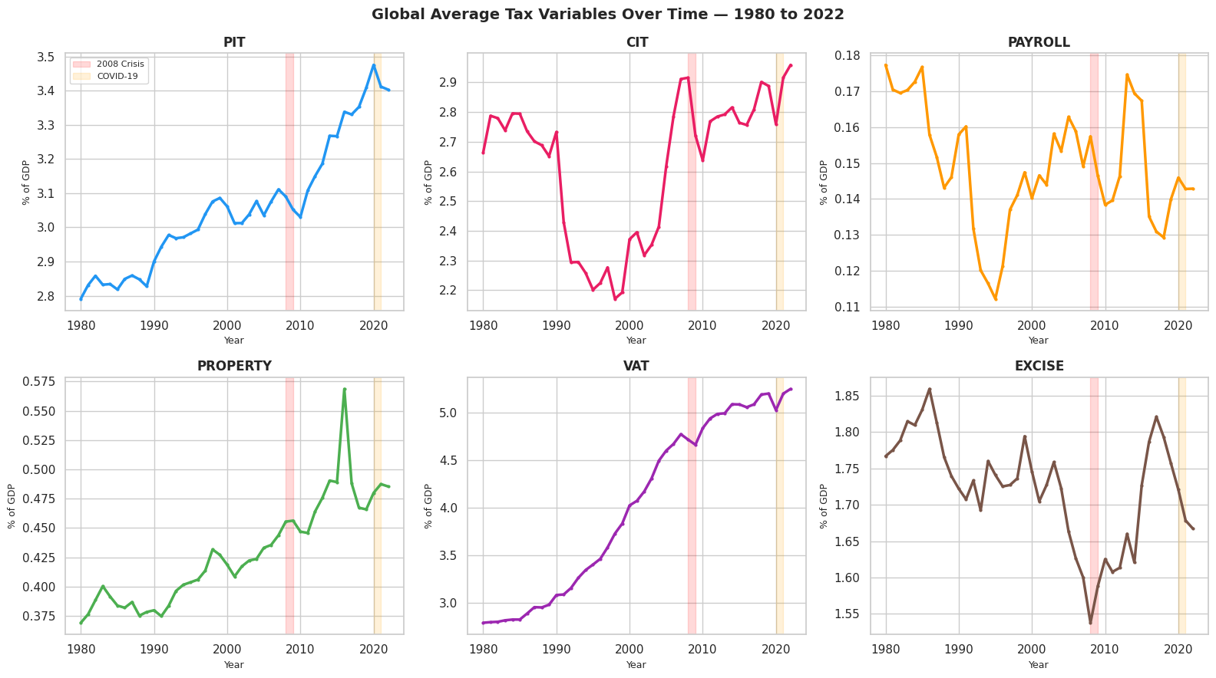
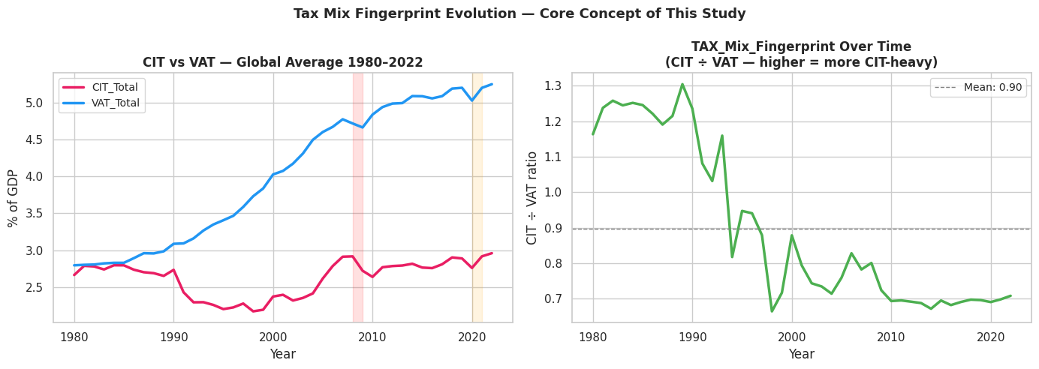
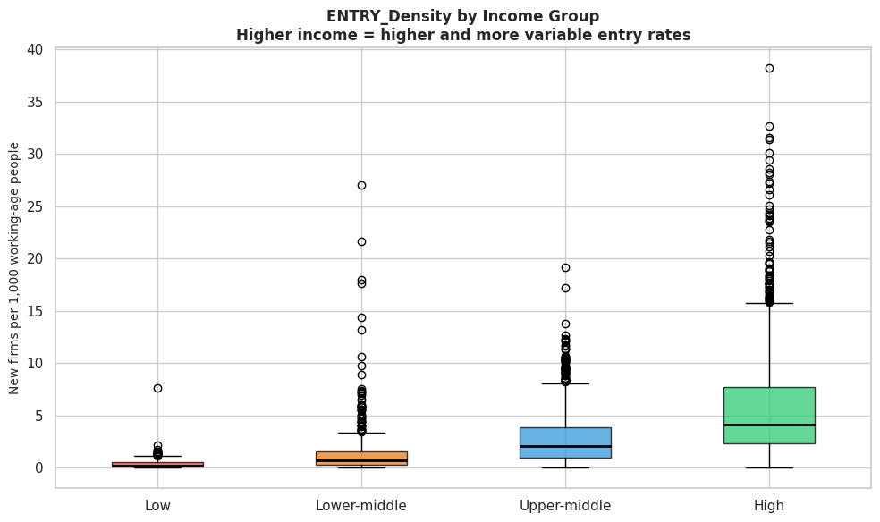
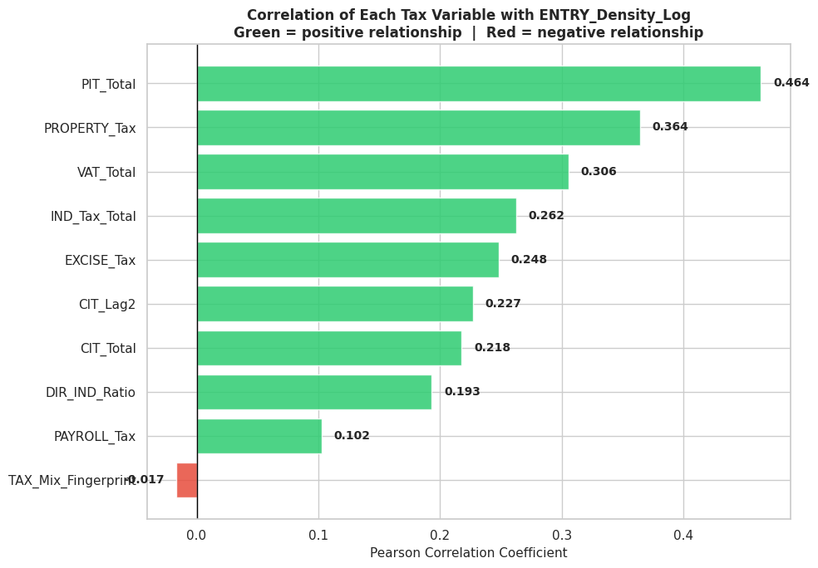
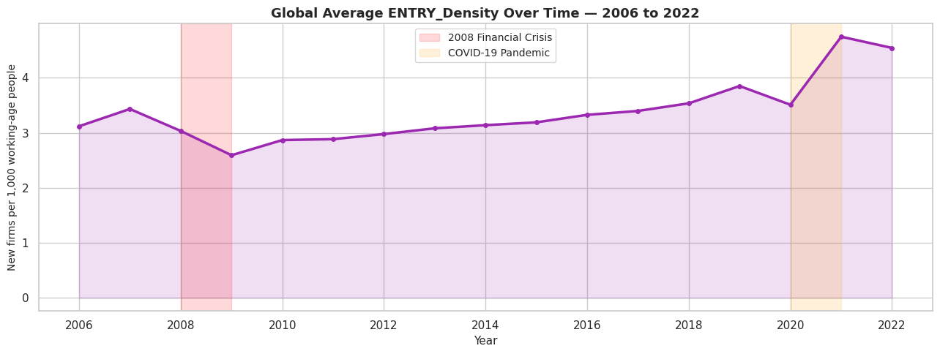
Exploratory Data Analysis - Visuals
↗
VAT doubled globally
↘
Tax Mix Fingerprint declined
15×
Entry density income gap
7 / 15

Slide 9
Dual-Track Modelling Design
Why two tracks - and what each answers
Statistical Baseline
OLS Regression and Fixed Effects
Track 1 - Regression
Track 2 - Classification
Target: ENTRY_Density (new firms/1,000 working-population)
Target: INC_Historical (income group 1-4)
Data: 2,312 rows · 170 countries · 2006-2022
Data: 8,408 rows · 196 countries · 1980-2022
Models: OLS → Fixed Effects → Random Forest → XGBoost
Models: Random Forest · XGBoost Classifier
Answers: RO1: Which taxes drive entry density?
Answers: RQ3: Which ML method best forecasts economic status?
Answers: RO3: Can AI predict future entry rates?
Answers: RO3: Does tax fingerprint encode development level?
8 / 15

Slide 10
Results - Regression Track (Track 1)
Predicting entrepreneurial entry density from tax structure
+215%
0.8437
>Swenson
Improvement over OLS
R² Score (XGBoost)
Exceeds literature max
XGBoost vs statistical baseline
Explains 84% of variation
Published benchmark: R² = 0.78
R² = 0.8437
R² = 0.8079
215% improvement
R² = 0.0616
R² = 0.2675
OLS Regression
Fixed Effects
Random Forest
XGBoost (tuned)
Baseline
Within-country
+202% vs OLS
★ Best model (pre-tuning: 0.8164)
★ Best model
9 / 15

Slide 11
Results - Classification Track (Track 2)
Predicting income group from 43-year tax history
91.49%
88.63%
91.49%
87.5%
Accuracy
Literature max: 87%
(Al-Karkhi 2025)
57.83%
0.9150
51.73%
F1 Score
4.5 pp
Logistic Reg.
Naïve Bayes
KNN
XGBoost
RF (tuned) ★
Above literature benchmark (Al-Karkhi 2025)
Misclassifications only between adjacent income groups - model learned real economic logic.
10 / 15

Slide 12
Tuning
Proving the model learned real economic relationships
Hyperparameter Tuning
Overfitting Check
Alternative Benchmarking
GridSearchCV · 5-fold CV
Train vs test gap analysis
6 alternative models tested
XGBoost R²: 0.8164 → 0.8437
RF Accuracy: 90.59% → 91.49%
All metrics improved across both tracks.
Classification gap: 0.08 ✓ (well within threshold)
Regression gap: 0.15 ✓ (acceptable for panel data)
No evidence of overfitting in either of our best models.
Linear Reg, SVR, KNN vs XGBoost (Regression)
Logistic, Naïve Bayes, KNN vs RF (Classification)
All alternatives outperformed on all metrics.
Validity Test - Without being told about any crisis, did the model predict the right direction?
2008 Financial Crisis
COVID-19 Pandemic (2020)
Actual drop: -0.892 (2007→2009) Predicted drop: -0.772 ✓ same direction
Actual drop: -0.315 (2019→2020) Predicted drop: -0.199 ✓ same direction
11 / 15

Slide 13
SHAP Explainability Analysis
Opening the black box - which taxes drive entrepreneurship and how
Personal Income Tax
0.2389
↑ Higher → more firms
VAT
0.1182
↑ Higher → more firms
Indirect Tax Total
0.1016
↑ Higher → more firms
Property Tax
0.0888
↑ Higher → more firms
Corporate Income Tax
0.0636
↑ Higher → more firms
Tax Mix Fingerprint
0.0346
↓ Higher → fewer firms
Payroll Tax
0.0236
↓ Higher → fewer firms
Key SHAP Discovery (RO2): Tax Mix Fingerprint (CIT÷VAT) < 0.44 → positive SHAP contribution (VAT-dominant promotes entrepreneurship). Above 0.44 → suppresses entry. First time this threshold is empirically derived at global scale.
12 / 15

Slide 14
The Artefact: Tax Response Engine Dashboard
Gradio-based interactive tool - 4 tabs · Real-time AI prediction
Tab 1
Tab 2
Tab 3
Tab 4
Country Explorer
Policy Simulator
Global Rankings & Map
Tax Mix Analyser
Select any country → 43-year tax trends · Tax Mix Fingerprint trajectory · Entry density timeline · 2008 & COVID shading · RO1 answers
Baseline vs policy change · AI predicts entry density + income group · SHAP explanation · Direct/Indirect comparison · RQ1 + RQ2 + RO3
Choropleth world map · Hover any country · Filter by region/income group · 3D rotatable scatter: Fingerprint × PIT × Entry Density · RO1 + RO2
Country-vs-country comparison · 3D fingerprint landscape · 2D threshold boundary · Concrete CIT reduction advice to reach optimal zone · RO2

Slide 15
Model Comparison & Literature Benchmarks
Both champion models exceed all published results
Regression Track - All Models
Classification Track - All Models
Model | R² | RMSE
OLS | 0.2675 | 0.6583
Fixed Effects | 0.0616 | 0.1859
Random Forest | 0.8079 | 0.3371
XGBoost ★ | 0.8437 | 0.3041
Model | Accuracy | F1
Logistic Reg | 57.83% | 0.5659
Naïve Bayes | 51.73% | 0.4953
KNN | 87.50% | 0.8745
XGBoost | 88.63% | 0.8867
RF (tuned) ★ | 91.49% | 0.9150
Literature Benchmark - This Study Exceeds All Comparable Published Results
R² ≈ 0.44
R² ≈ 0.38
R² ≈ 0.78
Acc ≈ 87%
R²=0.8437 / Acc=91.49%
Fairlie et al. (2025)
Nguyen et al. (2023)
Swenson (2024)
Al-Karkhi (2025)
This Study ★
OLS + FE
OLS + FE
Deep Learning
ML Ensemble
XGBoost + RF
14 / 15

Slide 16
Conclusion & Future Work
Theoretical
Methodological
Tax Mix Fingerprint operationalised. First global multi-tax ensemble study. Non-linear threshold of 0.44 empirically derived.
5-group hierarchical imputation outperforms single-method approaches. Dual-track design covers both regression and classification.
Empirical
Practical
XGBoost R²=0.8437 and RF 91.49% accuracy both exceed all comparable published benchmarks in tax-entrepreneurship research.
Tax Response Engine Dashboard: first globally deployable AI tool for real-time tax mix simulation with SHAP explanations.
Limitations: No macroeconomic controls · ENTRY_Density limited to 2006-2022 Future Work: Add GDP, inflation, governance controls · Causal inference (DID) · Sub-national (state/province) extension for federal economies
PRJ5158 Capstone Project II | Sunway Business School | Master of Business Analytics | April 2026

